Slide 1
DIGITAL PORTFOLIO
Subtitle

Slide 2
Digital portfolio
STUDENT NAME : R. HARISH DHARAN.
DEGREE : B.Sc. COMPUTER SCIENCE.
NM ID : 056E4A89587173B992D4D2048F16B91A.
EDUCATION : UNIVERSITY OF MADRAS.
COLLEGE : MANGALAM COLLEGE OF ARTS AND SCIENCE.

Slide 3
PROJECT TITLE:
INTERACTIVE DIGITAL PORTFOLIO USING
FRONT END DEVELOPMENT.

Slide 4
AGENDA:
PROBLEM STATEMENT
PROJECT OVERVIEW
END USERS
TOOLS AND TECHNOLOGIES
PORTFOLIO DESIGN AND LAYOUT
FEAUTURES AND FUNCTIONALITY
RESULTS AND SCREENSHOTS
CONCLUSION
GITHUB LINK

Slide 5
PROBLEM STATEMENT
Traditional resumes are limited and static, making it hard to convey creativity and real-world skills. A digital portfolio brings interactivity and personalization.

Slide 6
PROJECT OVERVIEW
This project is a personal digital portfolio website aimed at enhancing professional presence online . It allows users to display their career highlights, academic background, and certifications in an organized manner. Built with a focus on responsiveness and user experience, the portfolio serves as a central hub for self-promotion.
Key Features:
● About Me: Introduction and background
● Education: Academic history and milestones
● Skills: Technical and soft skills
● Certificates: Achievements and completed courses
● Contact: Simple form for communication or queries

Slide 7
WHO ARE THE END USERS?
STUDENTS (Academic projects, Resumes).
JOB SEEKERS (To share with recruiters).

Slide 8
TOOLS AND TECHNIQUES
HTML - Structure (Pages, Sectors).
CSS - Styling (colors, layouts, Responsiveness).
JAVASCRIPT - Interactivity (mobile navigation menu toggle).
VISUAL STUDIO CODE.

Slide 9
PORTFOLIO DESIGN AND LAYOUT
Home
About Me
Skills
Projects
Achievements
Contact
Responsive navigation with hamburger menu.
Responsive layout (mobile ,desktop view)

Slide 10
FEAUTURES AND FUNCTIONALITY
Responsive navigation bar with hamburger menu for mobile view.
Skills section displayed using simple list.
Certificates section displayed in grid format.
Contact details with email,-phone number.
Footer copyright.

Slide 11
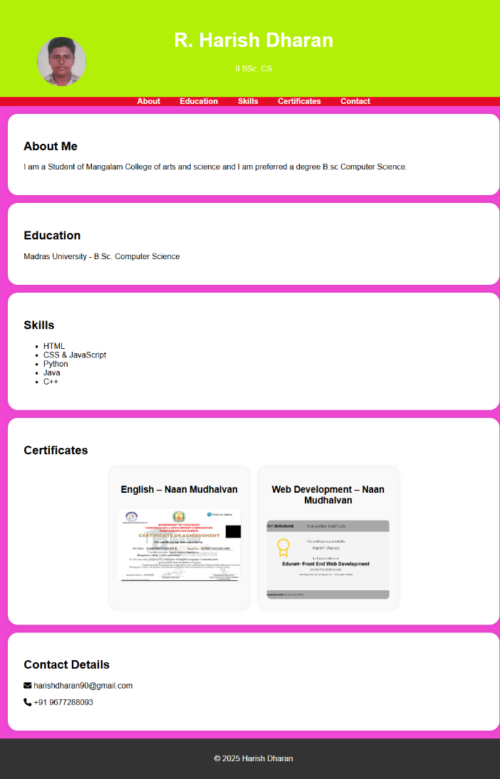
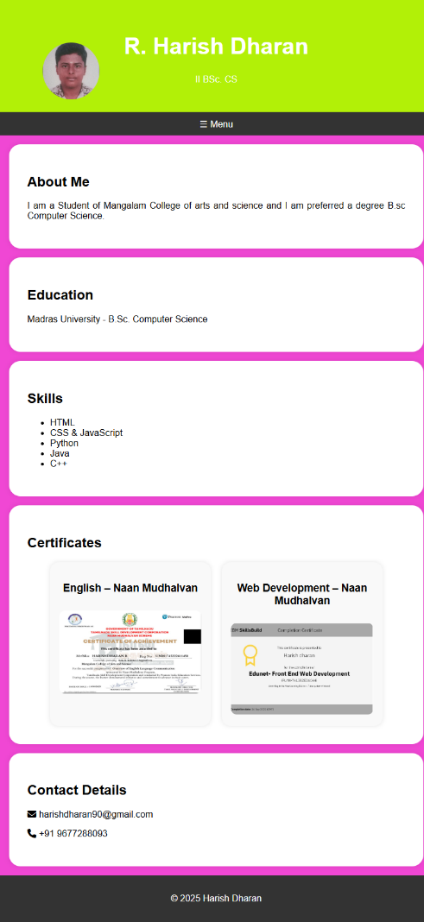
RESULTS AND SCREENSHOTS
MOBILE VIEW DESKTOP VIEW

Slide 12
CONCLUSION
The portfolio highlights my profile as a Computer Science student with an interest in fashion design. It includes key sections, a responsive layout, and a functional navigation menu.

